Slide 1
NJ-1040 Overview
NJ 1040

Slide 2
NJ 1040 Paper Page 1
Page I of the Paper NJ 1040 Tax Form includes
Taxpayer personal information
County/Municipality Code
NJ Filing Status
Exemptions
Dependent information
Gubernatorial Election Fund Check Boxes
Signature Box

Slide 3
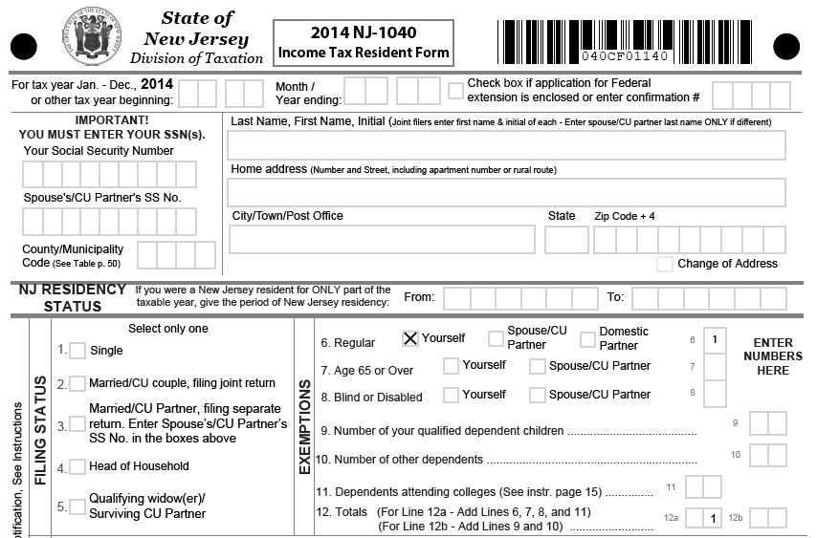
NJ 1040 Paper Page 1 Personal Information, Municipality Code, Filing Status, Exemptions

Slide 4
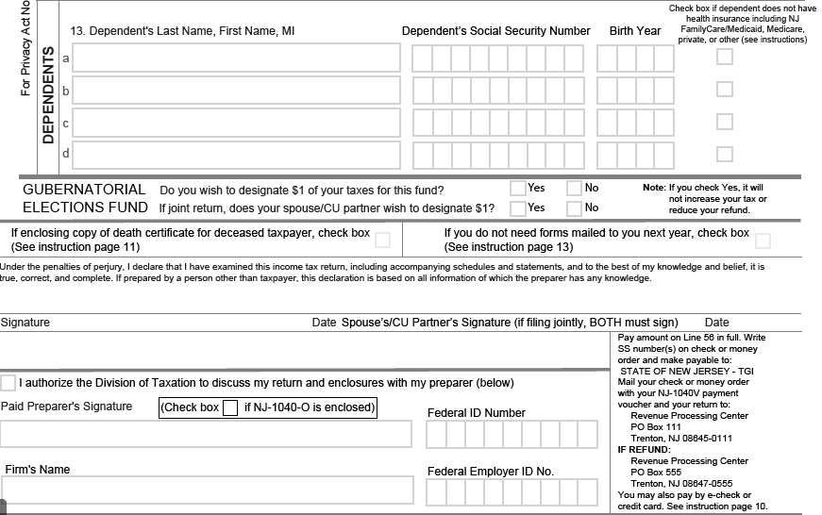
NJ 1040 Paper Page 1 Dependents, Gubernatorial Election Question, Signature Line

Slide 5
NJ 1040 Paper Page 2
Page 2 of the Paper NJ 1040 Tax Form includes
Income
Exclusions
Exemptions
Deductions
NJ Taxable income
NJ Tax

Slide 6
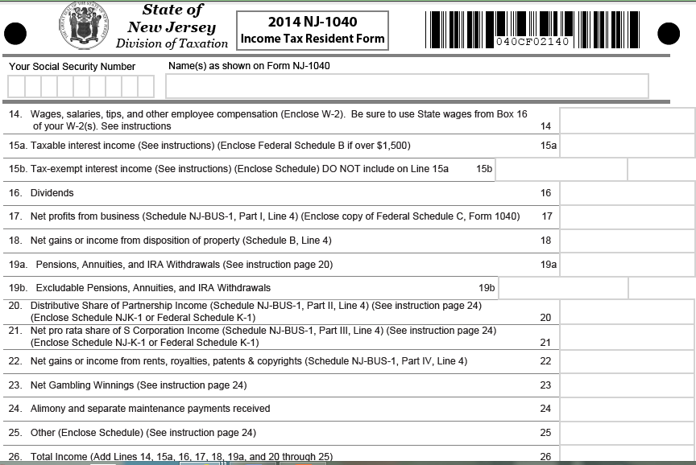
NJ 1040 Paper Page 2 Income

Slide 7
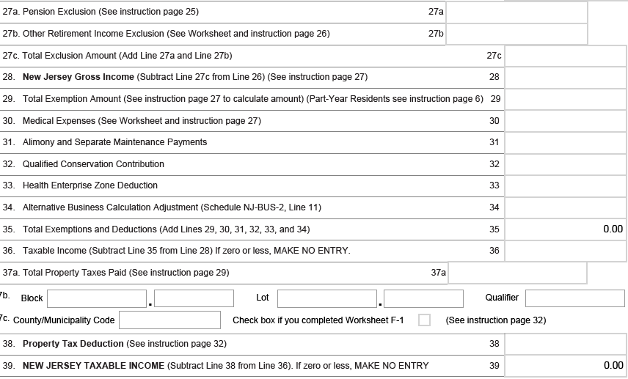
NJ 1040 Paper Page 2 Exclusions, Exemptions, Deductions, Taxable Income

Slide 8
NJ 1040 Paper Page 3
Page 3 of the Paper NJ 1040 Tax Form includes
Tax
Credits
Use tax on out-of-state purchases
Payments
Penalties
Amount owed
Contributions
Amount to be refunded

Slide 9
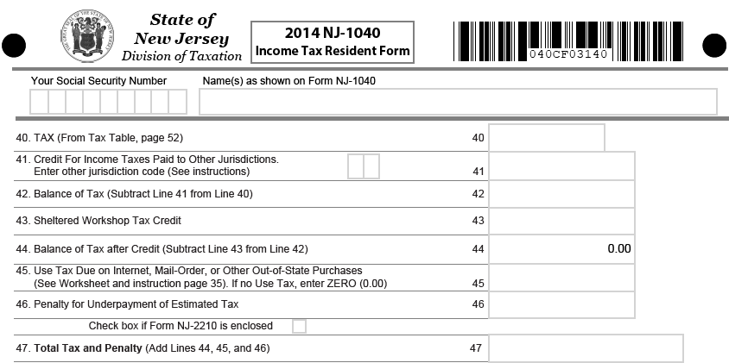
NJ 1040 Paper Page 3 Tax, Credits, Use Tax & Penalties

Slide 10
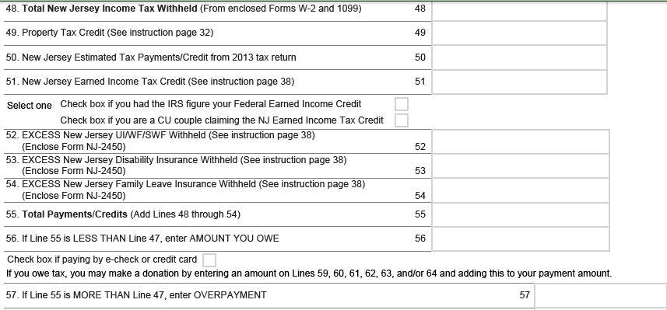
NJ 1040 Page 3 More Credits, Payments, Contributions, Refund/Owed

Slide 11
NJ1040 Paper Page 4
NJ Paper Page 4 is the NJ 1040H – Property Tax Credit Application
Not in TaxWise – Paper file only
Used for certain taxpayers that do not file a NJ return but are entitled to a property tax credit
Details to follow in Tax Law training modules

Slide 12
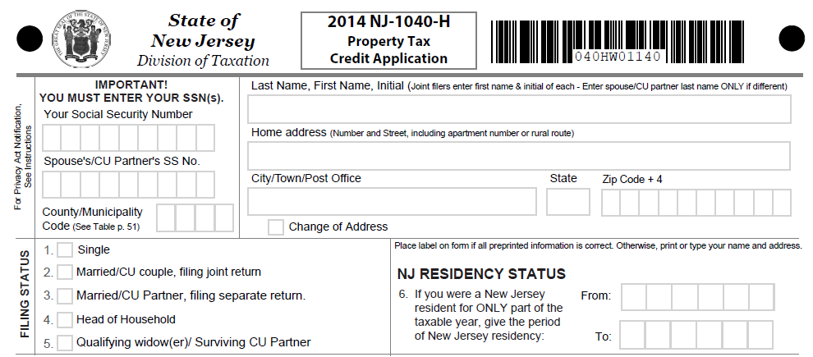
NJ 1040H

Slide 13
TaxWise NJ 1040
Page numbers in TaxWise do not match page numbers of the paper return, but all information is the same
Most of the information is carried forward from the TaxWise Federal 1040 to the TaxWise NJ 1040
NJ 1040 entries can be tricky

Slide 14
TaxWise NJ 1040 Entries
The following items are the minimum required manually input entries:
County/Municipality Code must be entered on page 1 of TaxWise NJ 1040
Gubernatorial Election Fund Question must be answered on page 2 of TaxWise NJ 1040
Property tax info for block/lot & municipality code must be entered on page 3 of TaxWise NJ 1040
Use tax due on out-of-state purchases must be entered on page 3 of TaxWise NJ 1040
Worksheet F Property Tax Deduction/Credit info must be entered on page 3 of the TaxWise NJ 1040
NJ DD Worksheet must be completed

Slide 15
NJ 1040 for Familiarization
For Familiarization we are entering just basic NJ items
Resource for NJ 1040 is “New Jersey Special Handling” document found on the TaxPrep4Free.org web site
More detail on NJ coming later

